Slide 1
GRIP

Slide 2
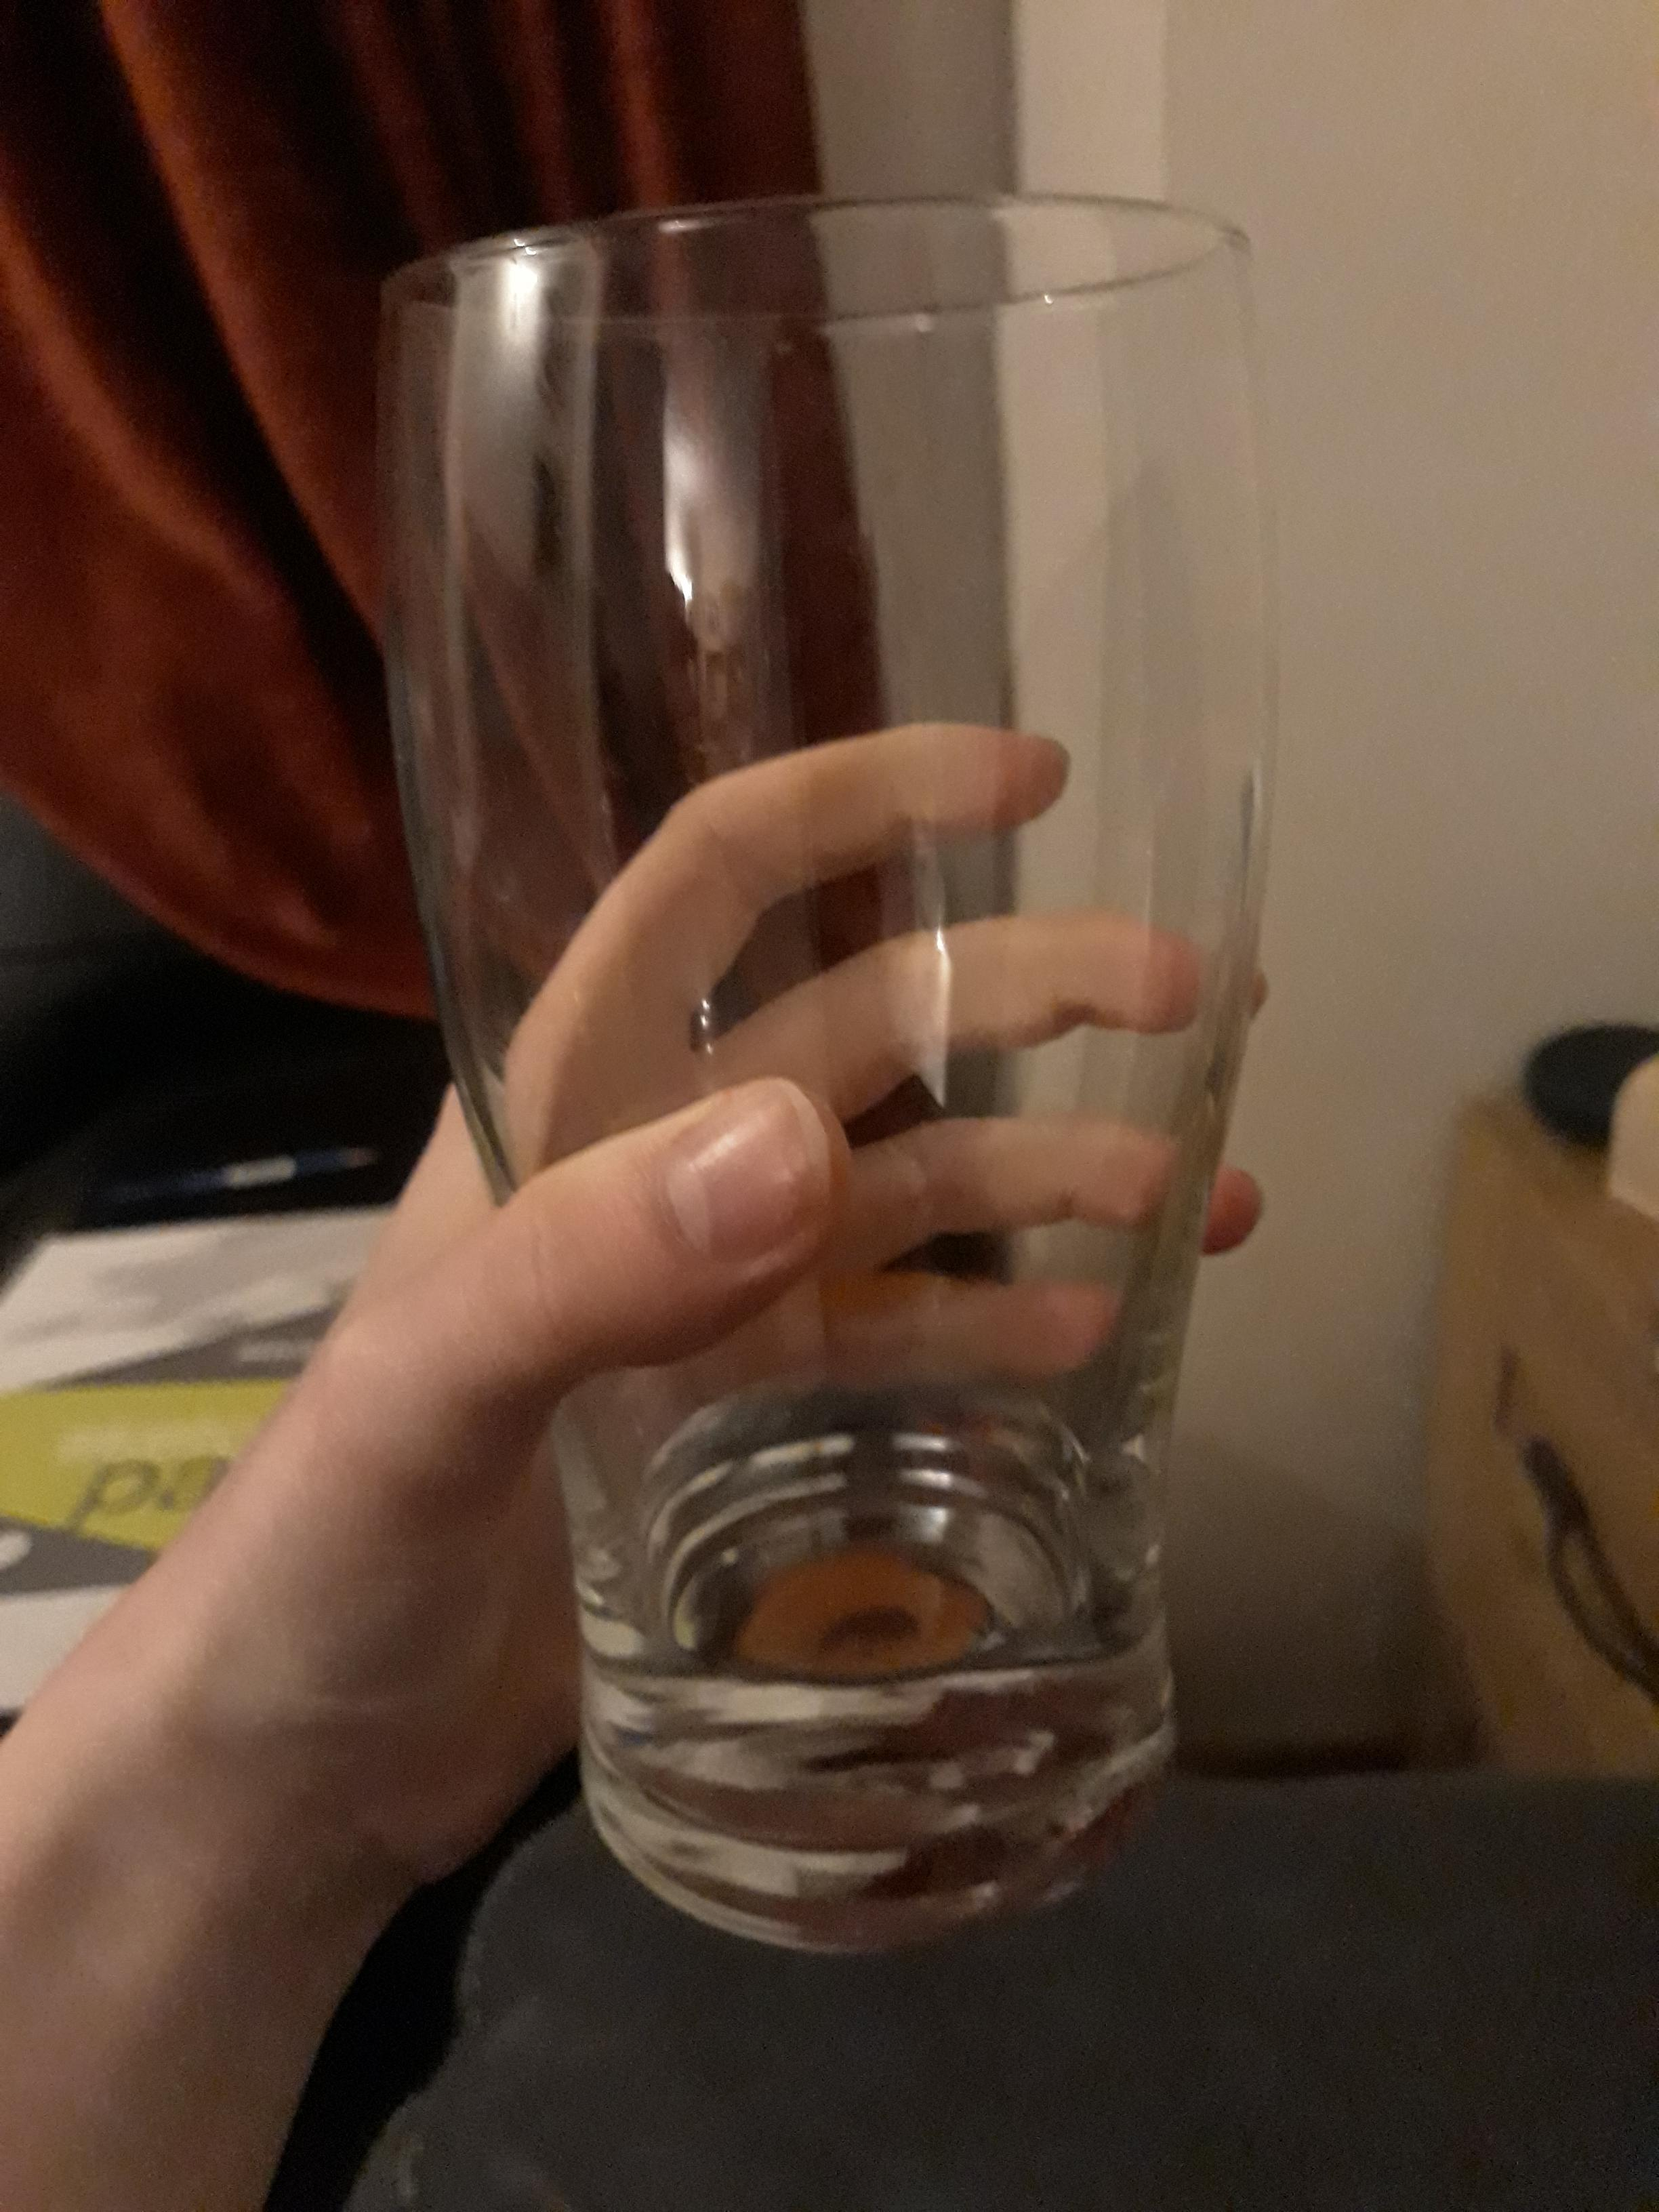
What is grip?
Grip: Take and keep a hold of something; to grasp.
From a perspective of Graphics, grip is the things you can hold and the designs that can benefit this.

Slide 3
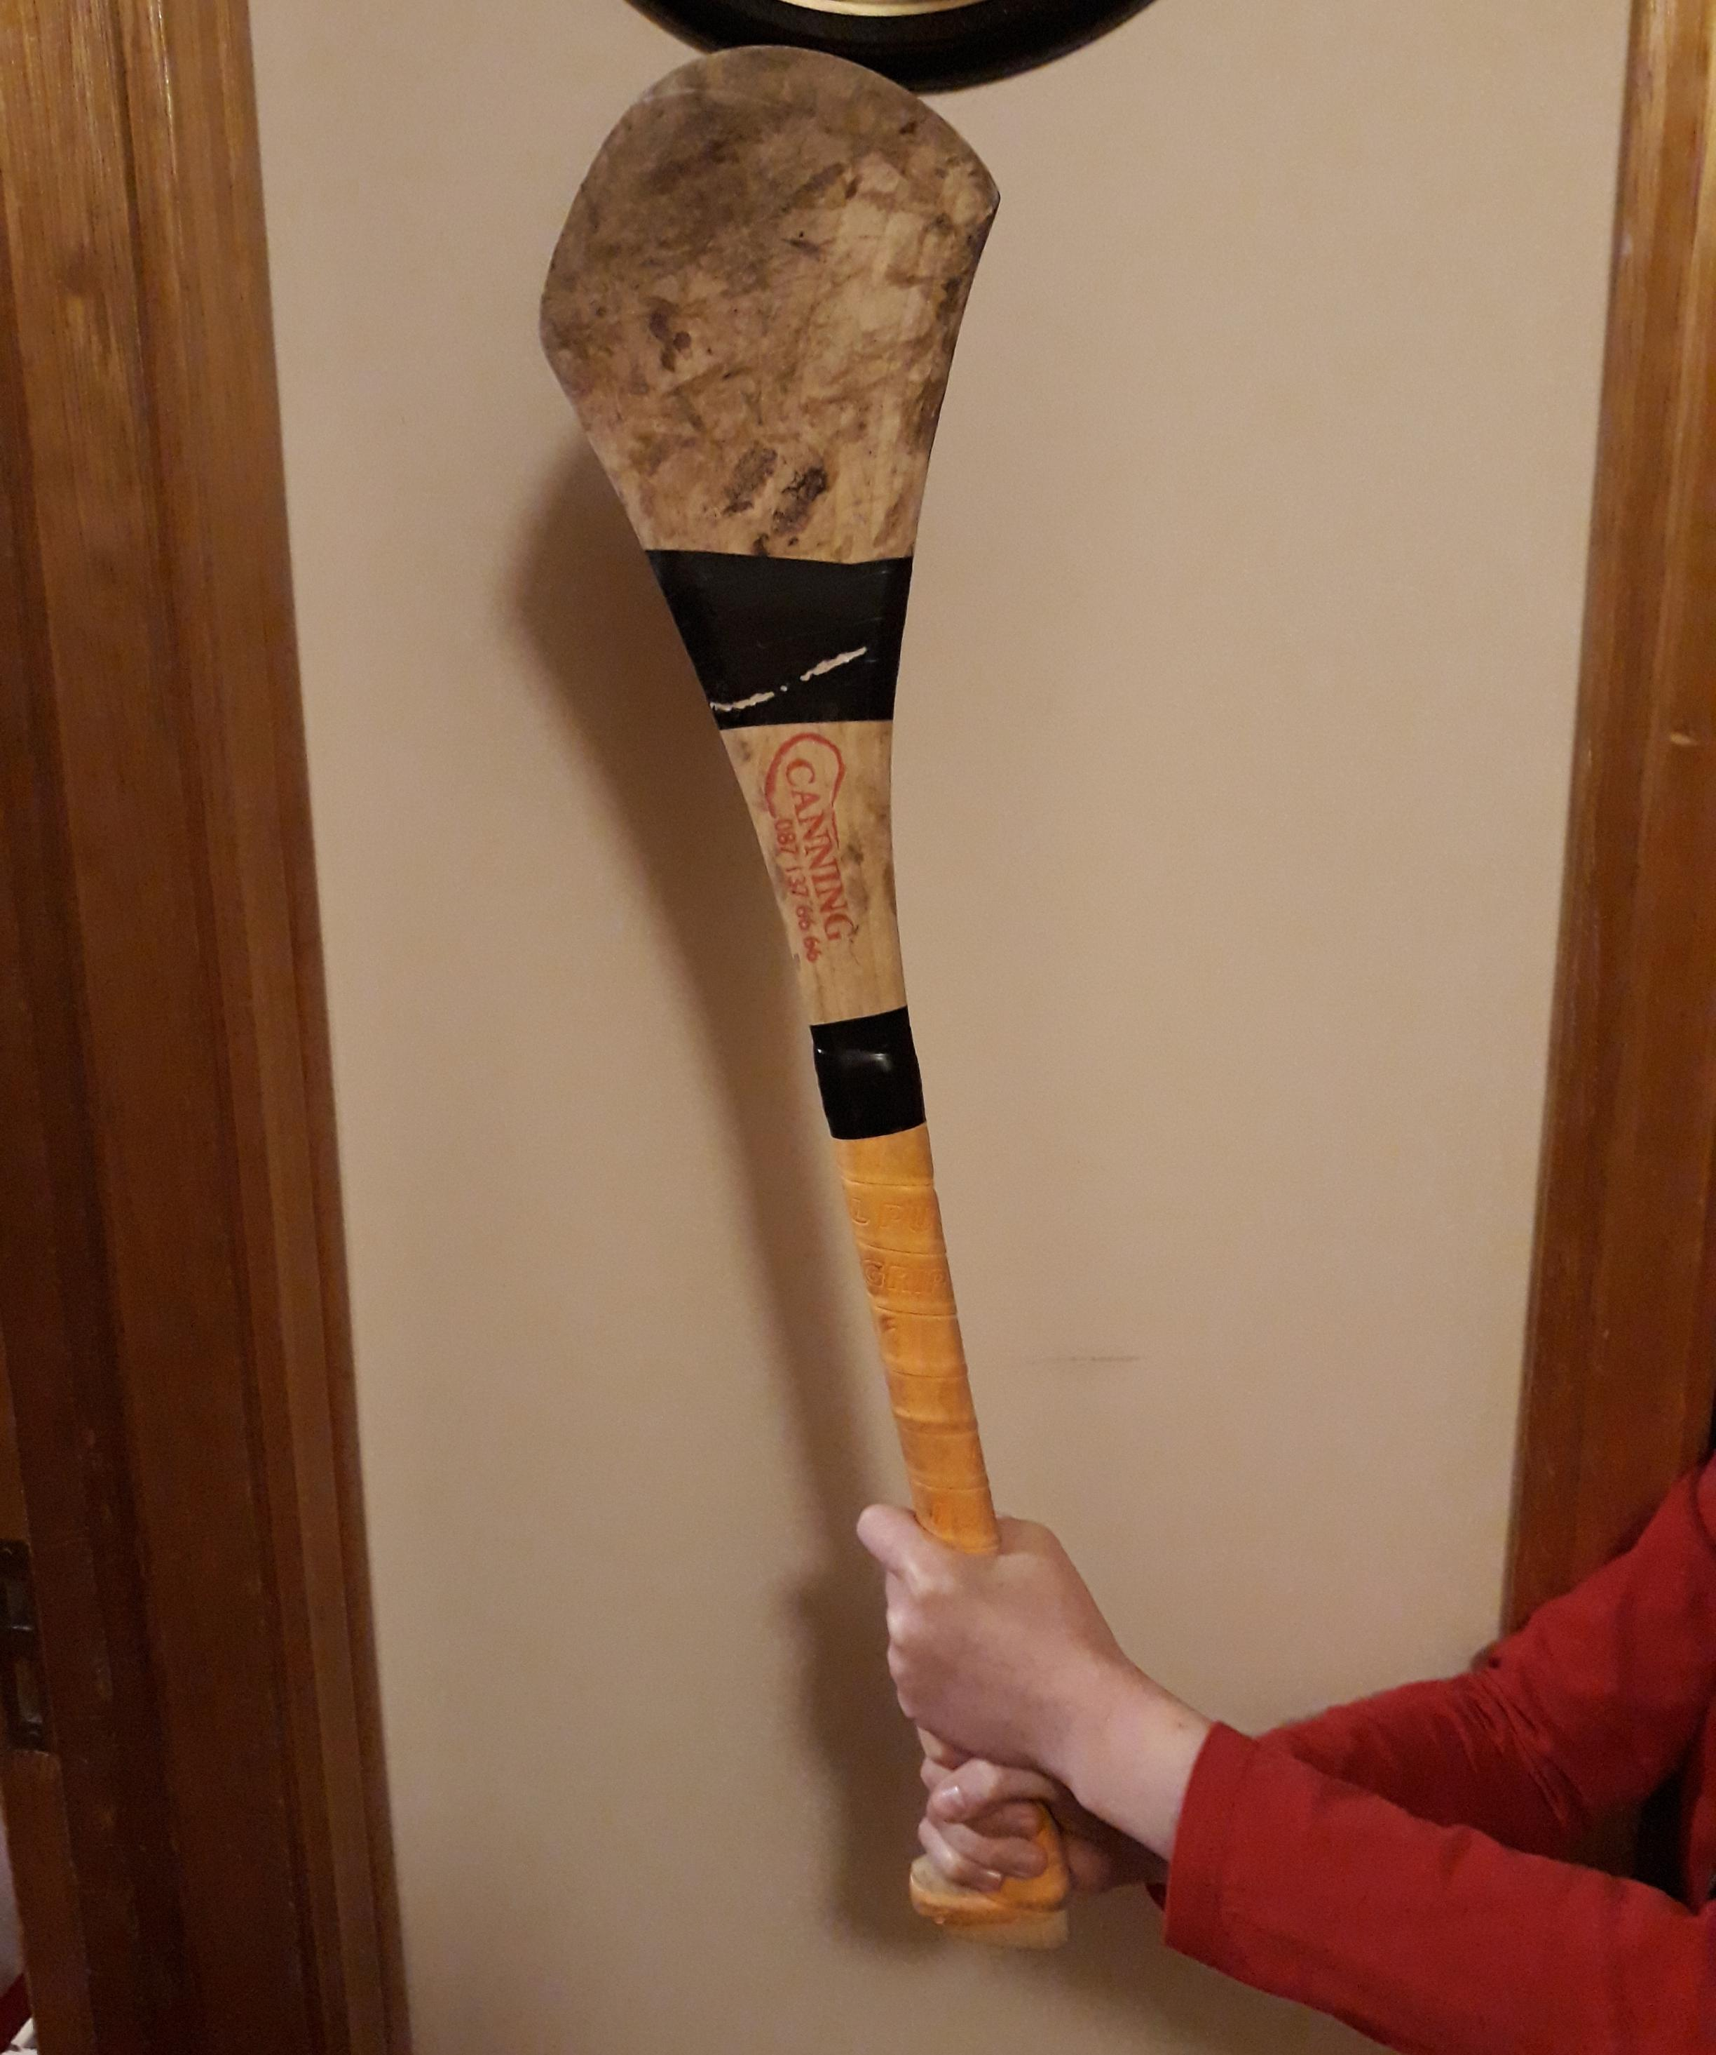
Hurley
Material: wood
Hurleys are typically made of wood or hard plastic, both of which get slippery when wet which can make them hard to grip. Because of this, most hurleys come with a grip that allows them to be used in any weather.

Slide 4
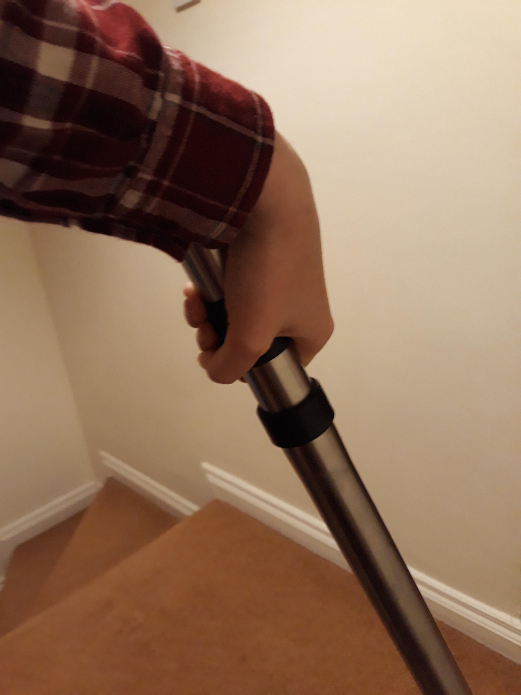
Vacuum
Material: metal
It has a circumference of about 9cm which was almost identical to a brush handle I measured. I assume that the similarities were not coincidental, rather that they are designed that way as it makes them both easy to grip.

Slide 5
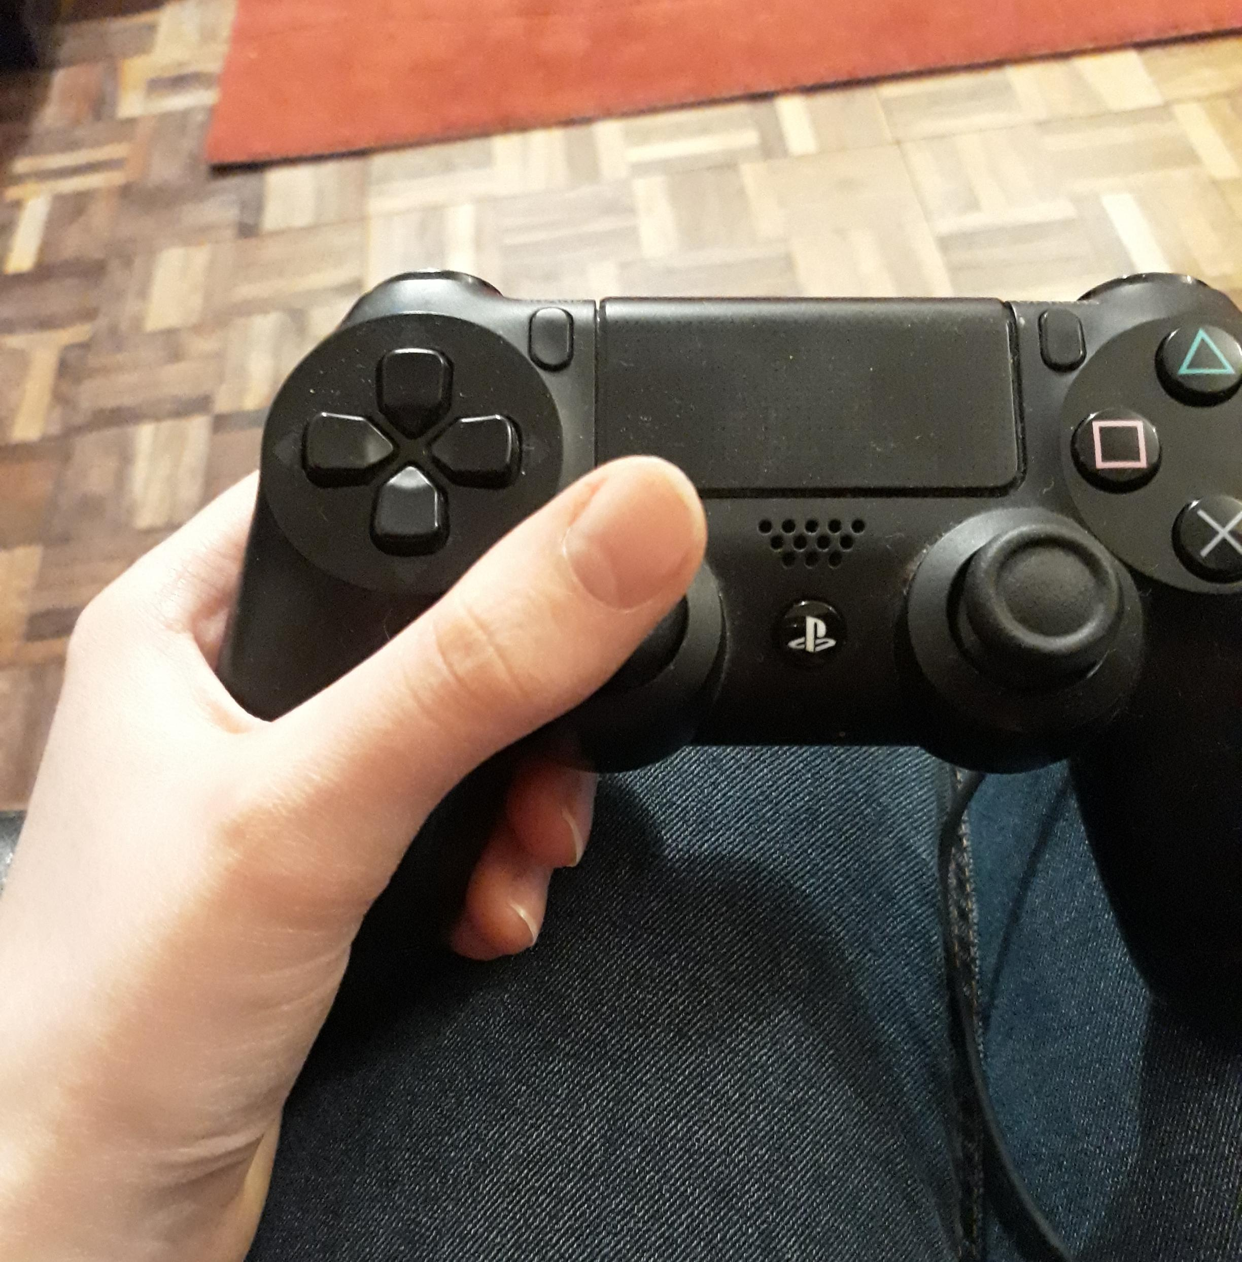
Game controller
Material: plastic
The control handle is made of a textured plastic that prevents your hand from slipping.

Slide 6
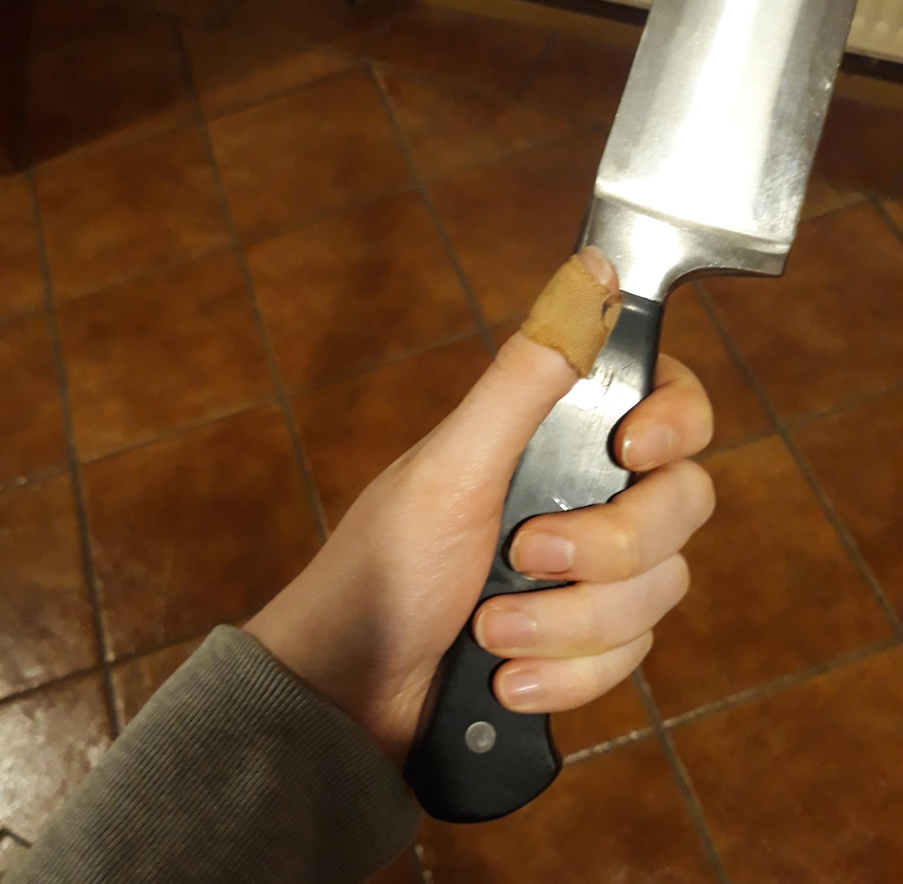
Knife
The handle of the knife has grooves in it that makes it easier to hold And less sheer.

Slide 7
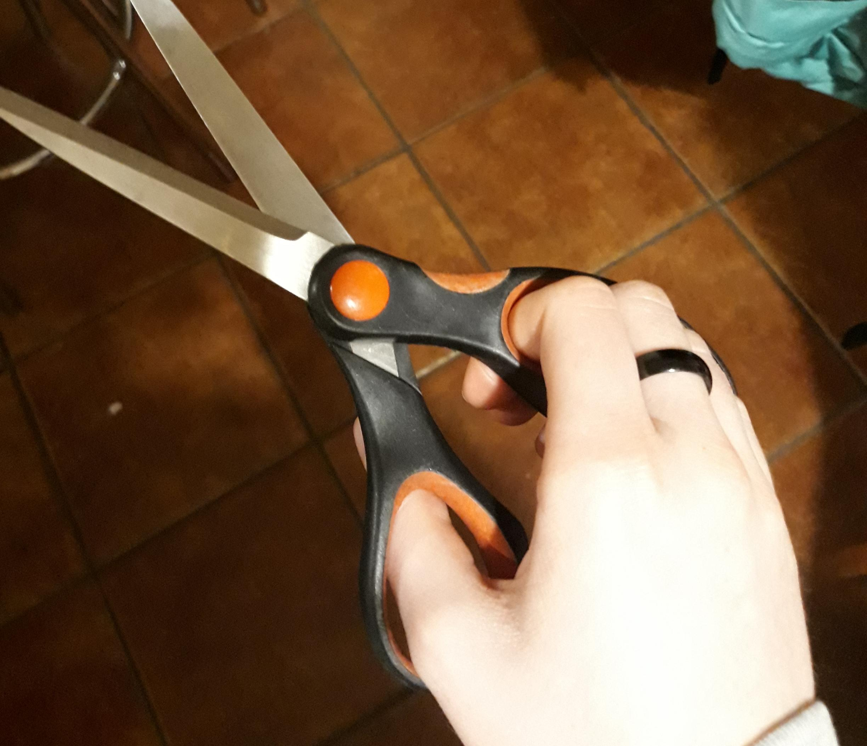
Scissors
The main handles of the scissors are made of hard plastic, but the part that you grip is made of rubber to prevent your hand from slipping.

Slide 8
Different things are designed in different ways to better the use of the product.
For example, it wouldn’t be good to make a hurley from the same material you would make a game controller with. The plastic of the controller would become slippery if it got wet, which a hurley would if it was used outside.

