Slide 1
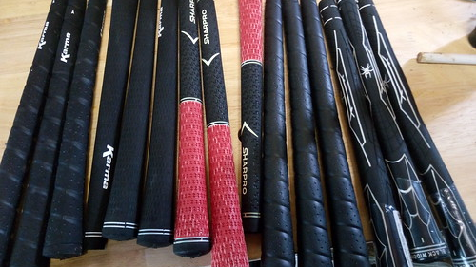
Get a Grip
Nolan Damico

Slide 2
What are grips?
Grips allow you the ability to Hold onto an object
Grips are usually comfortable, stable and/or strong

Slide 3
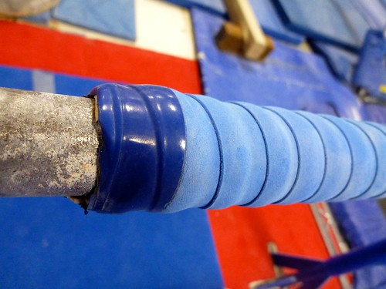
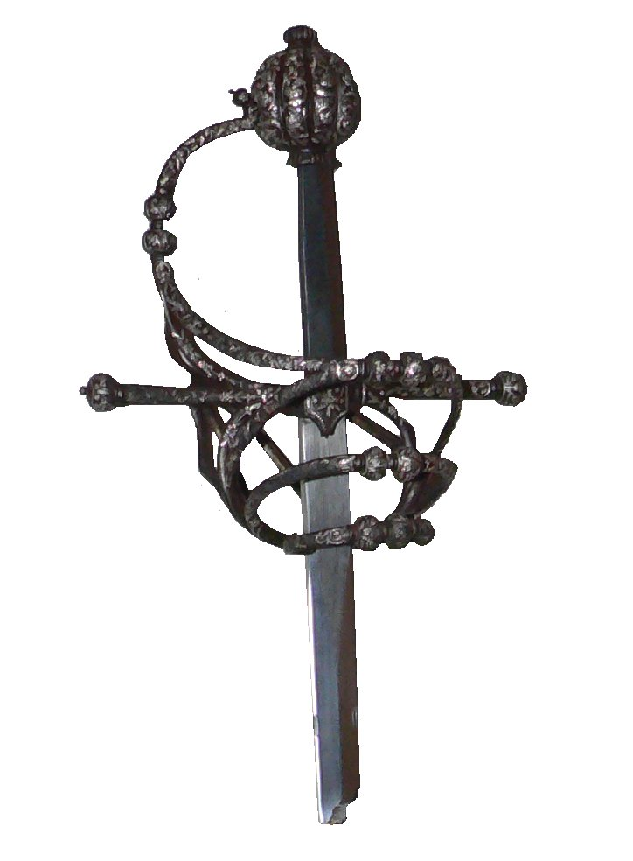
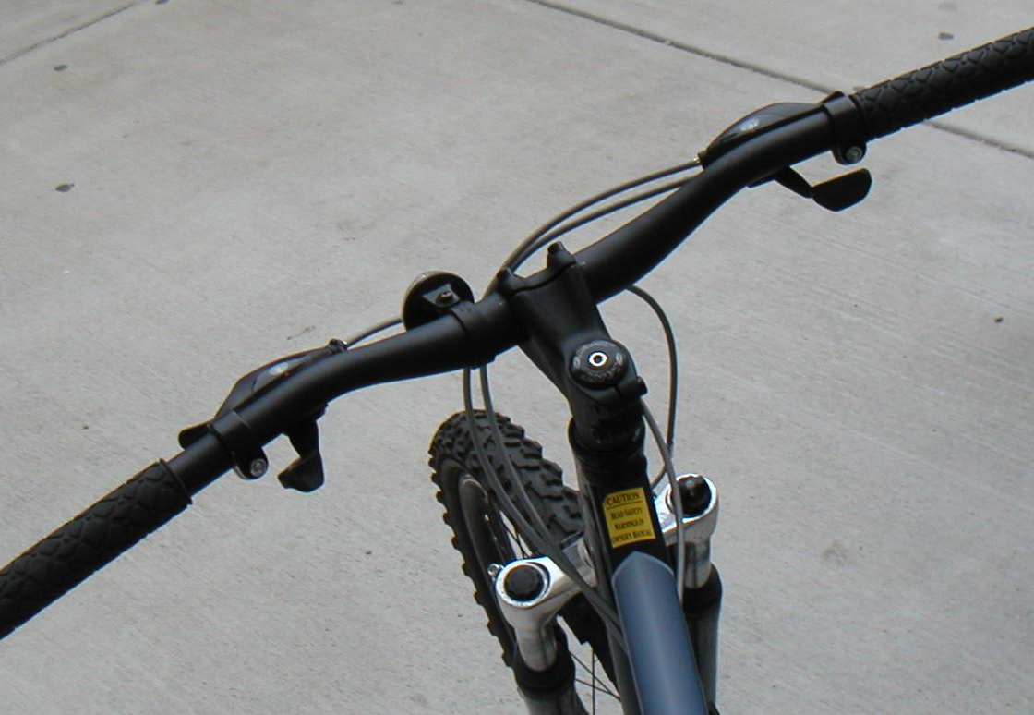
List of items that use grips:
Bicycles
Hammers
Blades
Guns
Golf Clubs
Drills
Utensils
ETC.

Slide 4
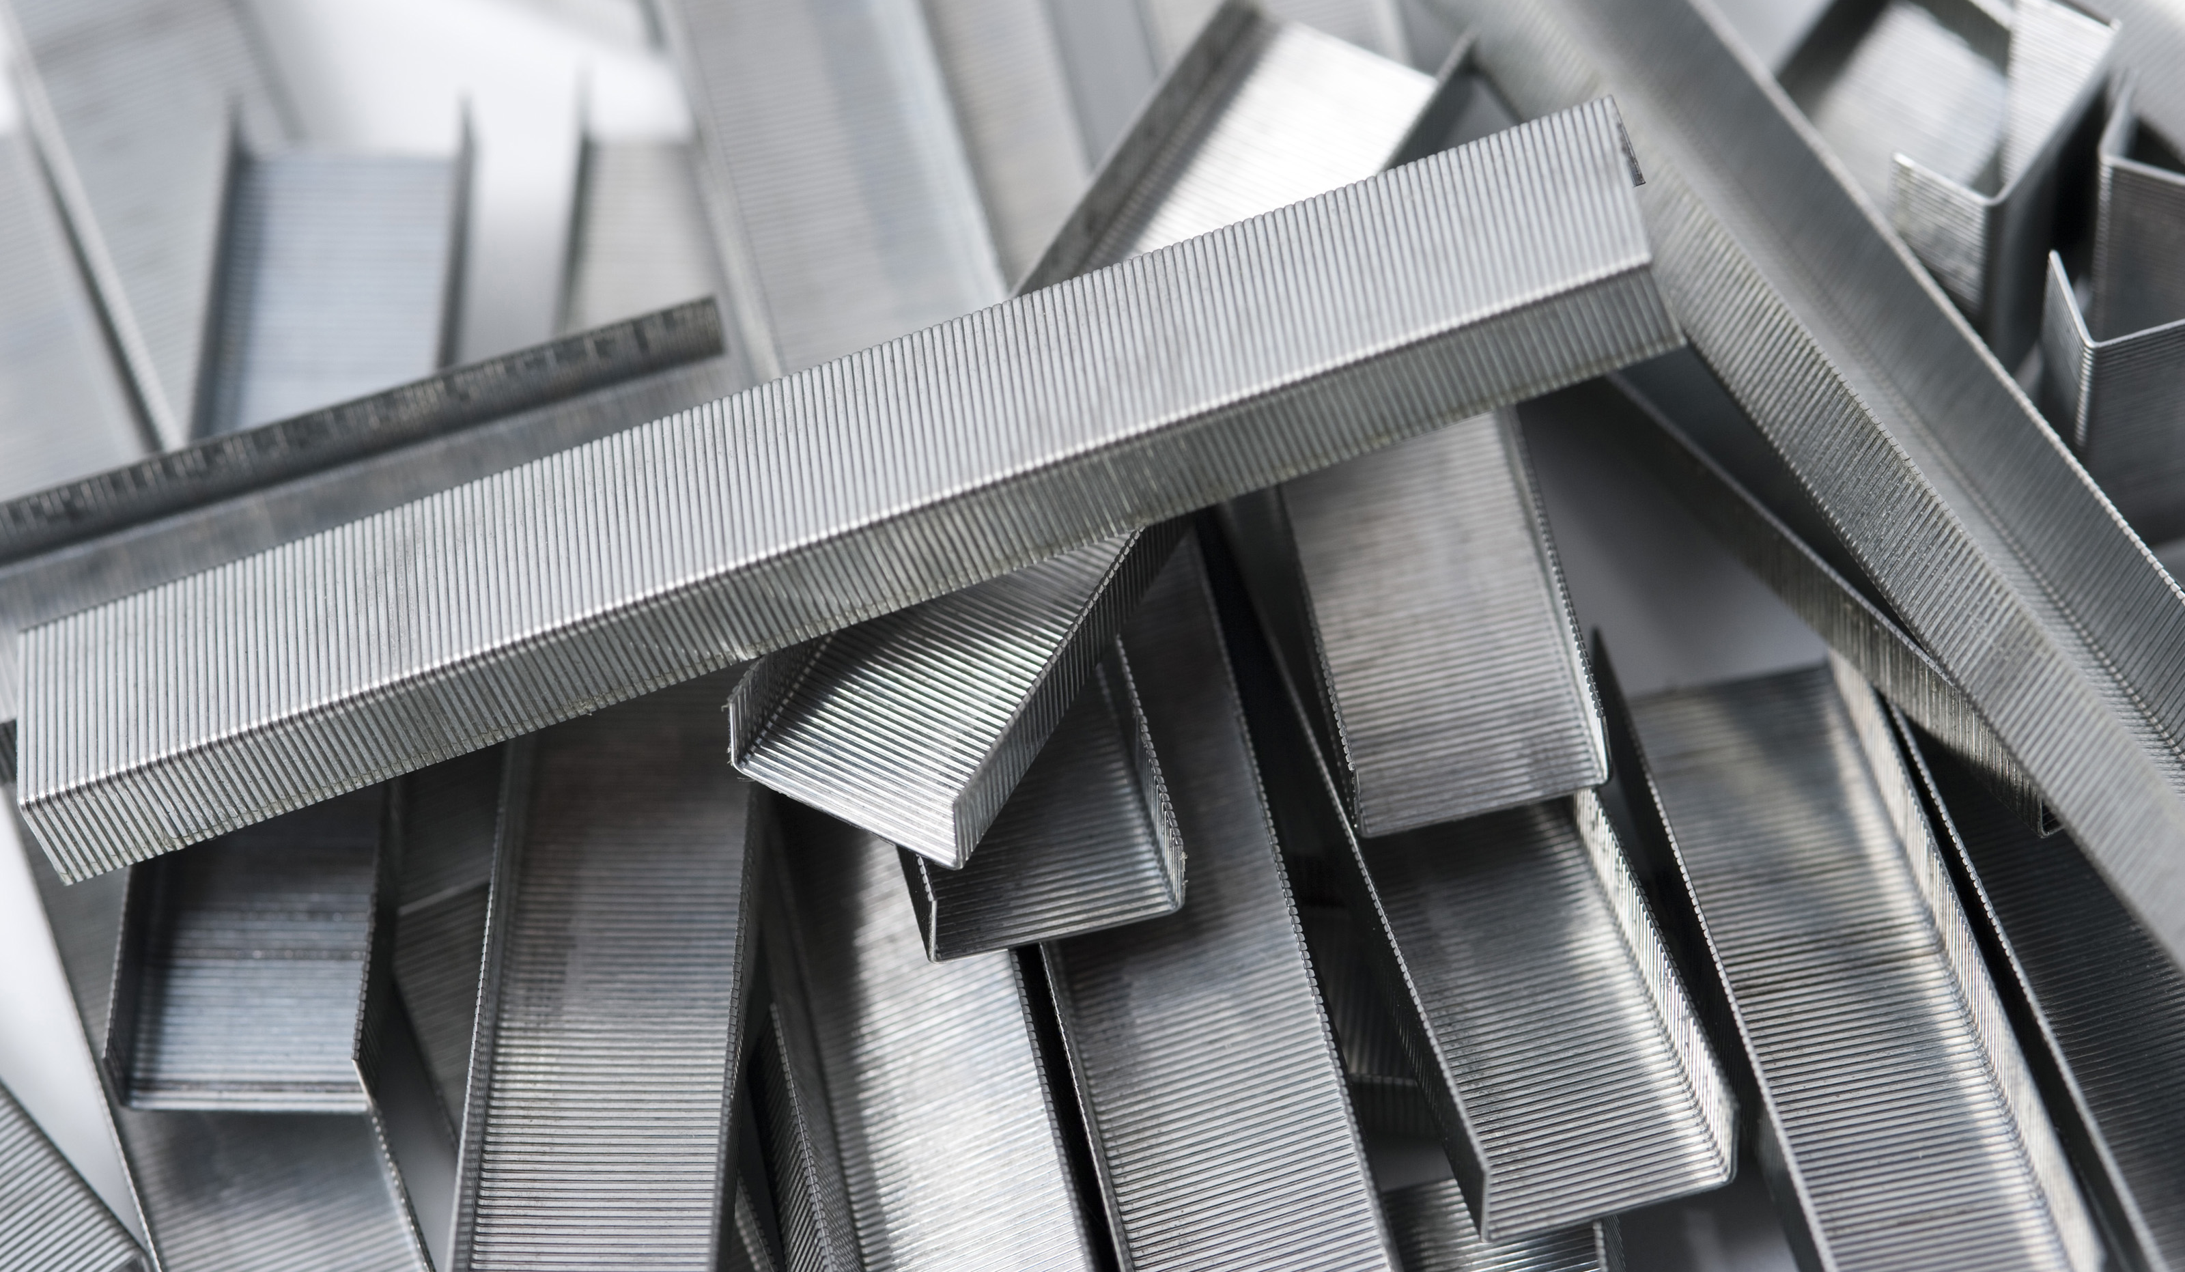
Some Examples of Materials in Grips and their functions
Rubber: Slip proof and not sticky, Reduces hand numbness, does not harden or fade, and very durable Example: Bike grips
Plastic: it's resistant to force, and good for younger kids. Example: Plastic toys
Metal grip: It's very Hard and will most likely never break, But uncomfortable to grip, also very dense. Example: weights

Slide 5
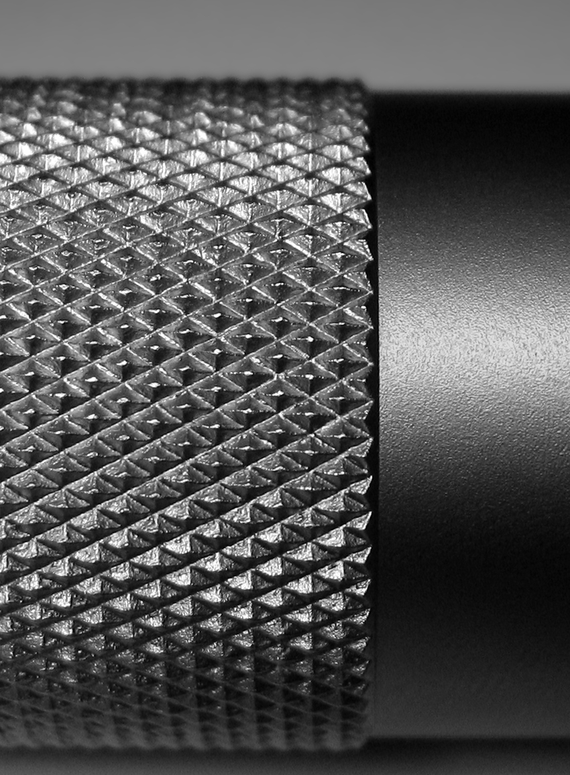
Grip Shapes and Patterns
Grips are usually a cylinder because that’s the form your clenched hand is most comfortable with, But they come in other shapes too.
Patterns also help with grips, as one may be for comfort and another for safety. A bikes texture is for comfort and being able to tightly grip it. while a gun's grip Pattern will be for safety so that you can hold it and not have it fall out while you shoot.

Slide 6
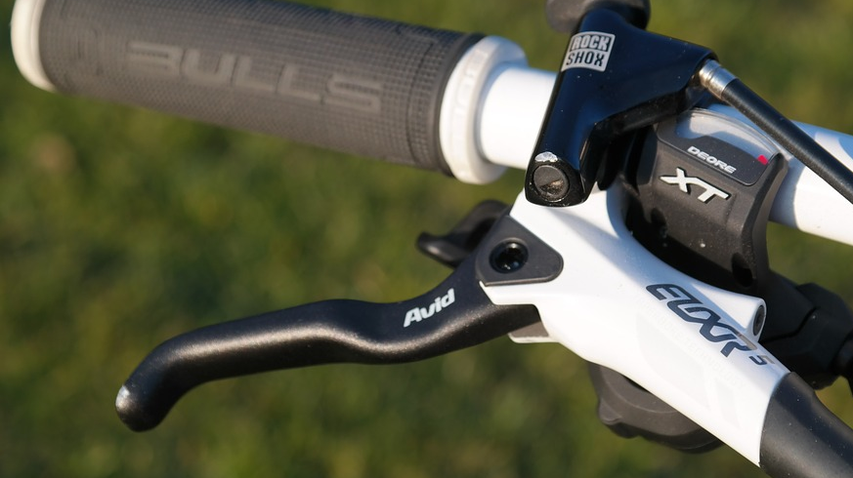
The Science behind grips
A swords grip protects it from impact and absorbs some of the blow, the guard of the handle is so your hand doesn’t move too much forward, slide off, or get cut. It's got a Pommel so that the hand doesn’t retract back and drop the sword.
In a bike the grip is used so that you don’t accidentally drop the handlebars since Rubber is much easier to grip than Iron. And it's also so it's easier to maintain the direction you're going in.

Slide 7
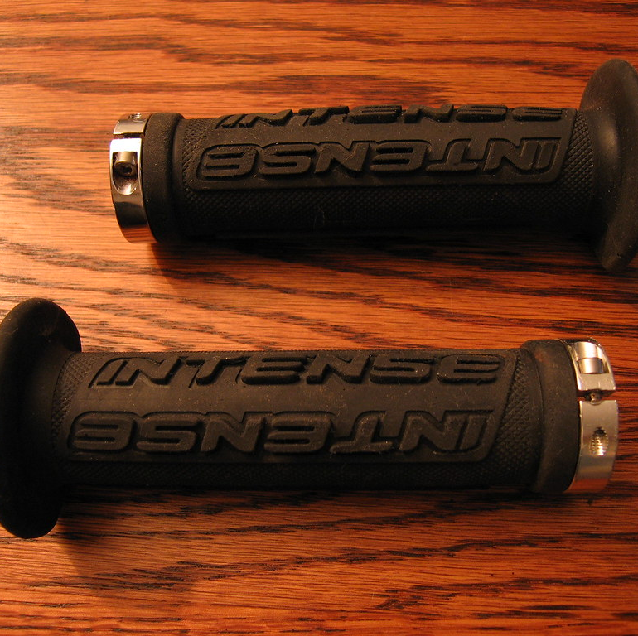
How I use grips in everyday life:
I use a spatula's grip to hold it while I make something with a cooker.
I use a grip of a Lawn mower to protect my hands and hold it.
I use a knife grip to cut vegetables and fruits.
I use the grip of a bicycle for steering
My backpack's handle is a grip I use for carrying it when I'm in a rush.
This Photo by Unknown author is licensed under CC BY-NC-ND

Slide 8
