Slide 1
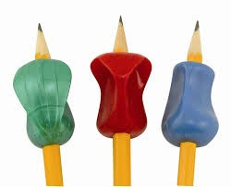
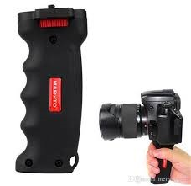
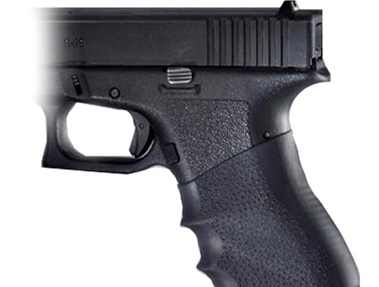
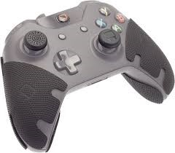
Grips
Sam

Slide 2
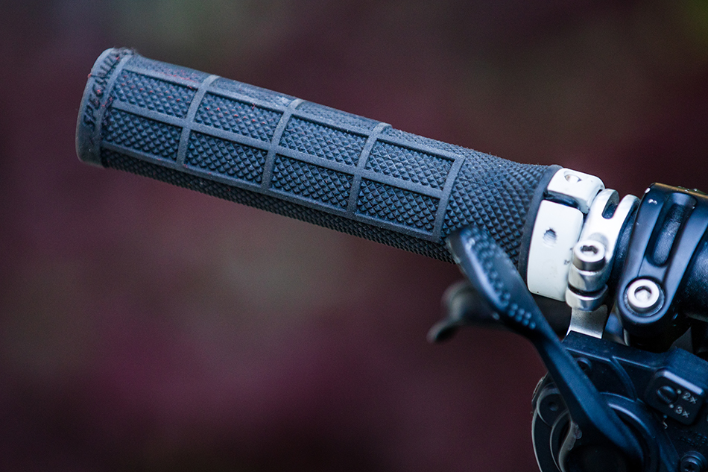
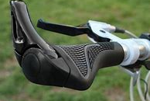
What are grips?
Grips are the way we engage with products we hold, grips need to be made of a material suited for the product.
For example: The grips on a bicycle's handlebar need to be sweat resistant to ensure the person's hand doesn't slip, and ergonomic suited for the average person's hand.

Slide 3
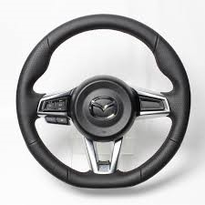
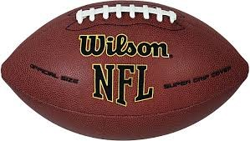
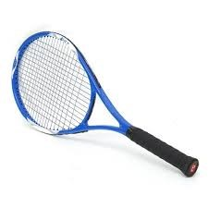
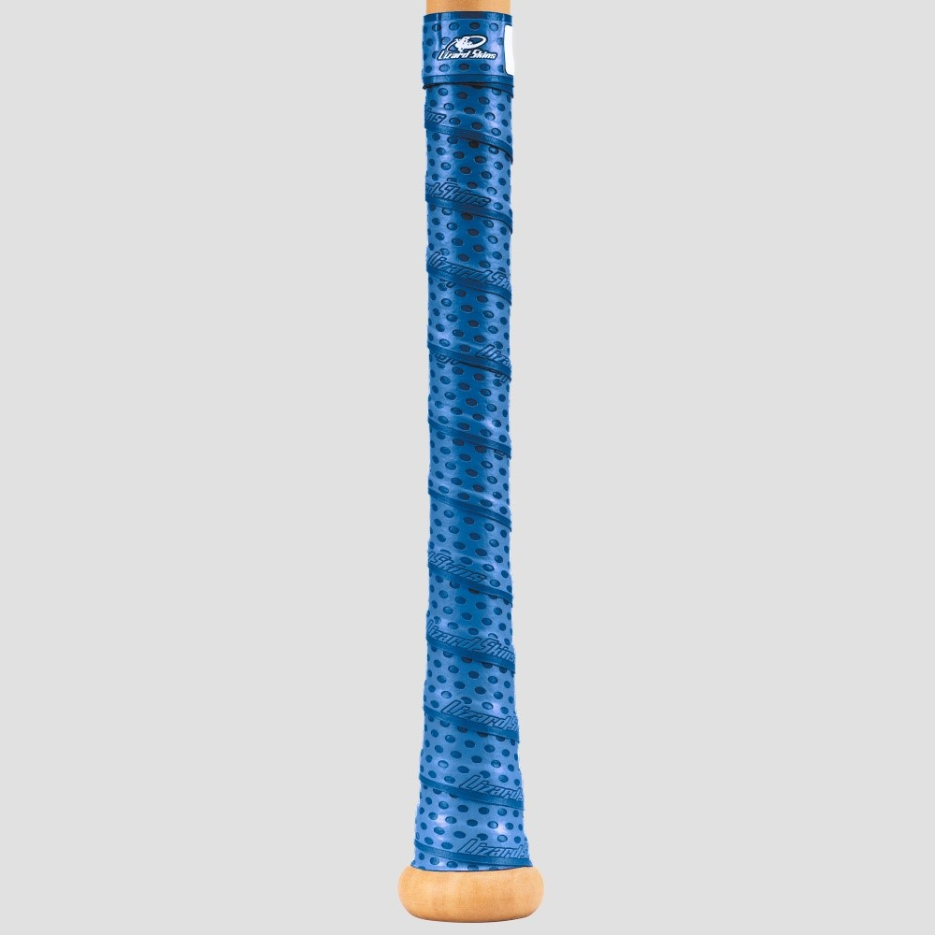
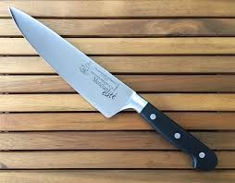
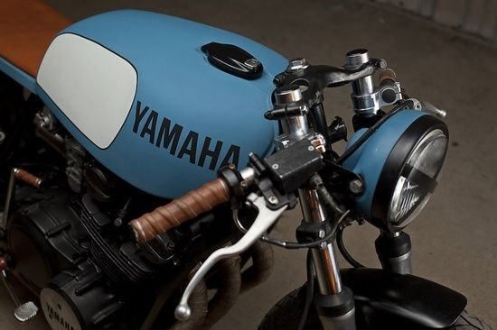
Examples of grips
This steering wheel is made from leather with grooves to keep the hands in the 10 and 2 position
This football is made from leather with a plastic finger-grip at the top
This pencil is fitted with plastic grips with finger indents
This baseball bat has a carbon fiber grip with dividers to ensure the fingers don’t slip
This knife has a plastic grip with a curve at the end to ensure the hand doesn't slip
This handle is made from leather with dividers to ensure the fingers don’t slip.
This tennis racquet has a rubber grip.

Slide 4
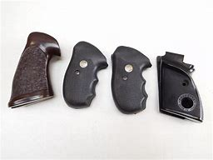
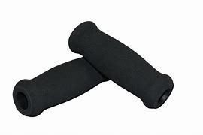
Materials used for grips
Grips can be made from many materials, each suited to the product but each have their pros and cons.
Rubber – Slip resistant, short life span, water resistant, flexible, cheap.
Leather – Comfortable, long life span, flexible, water resistant, expensive.
Plastic - Durable, cheap, light weight, rigid, water resistant.
Carbon Fiber - Strong, light weight, long life span, rigid, water resistant, slip resistant.
Wood - Expensive, strong, rigid, water resistant, durable.
Foam – Short life span, cheap, not water resistant, flexible, comfortable.
Assorted gun grips made from rubber, leather and carbon fiber.
Two foam bicycle grips.

Slide 5
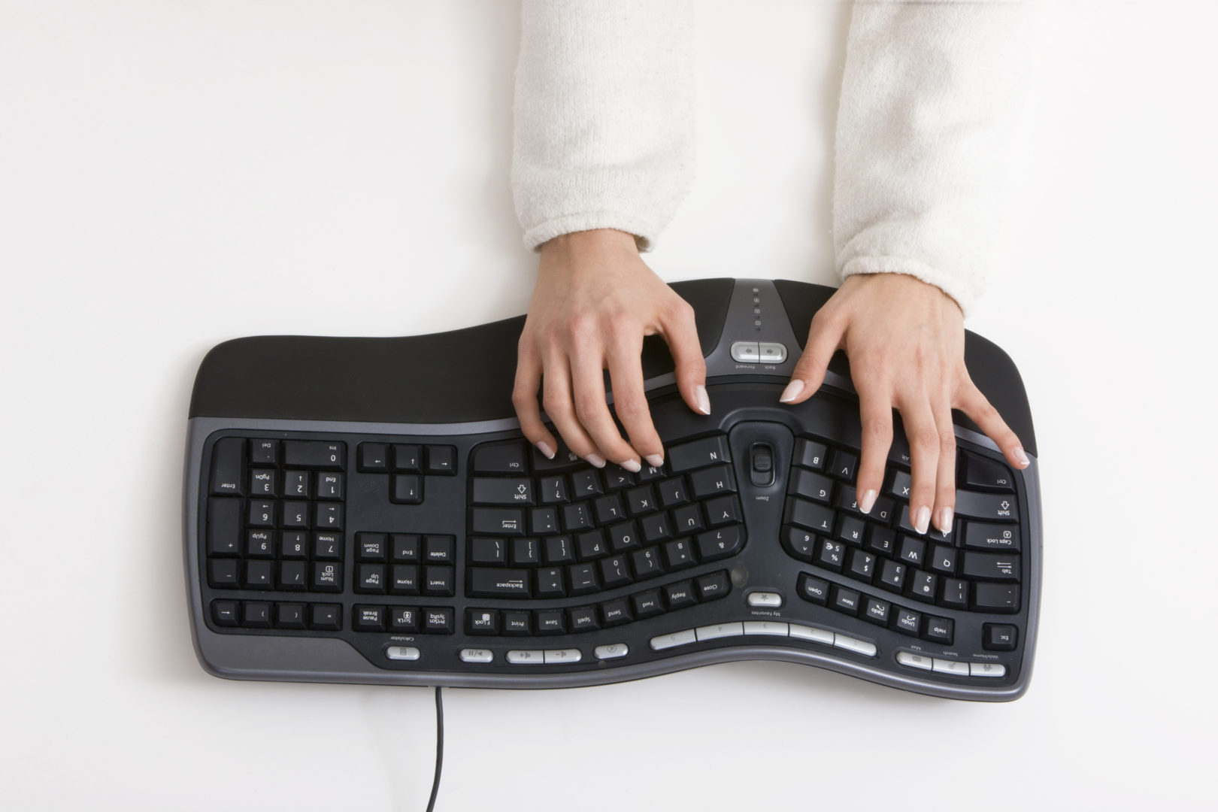
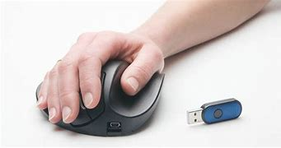
Ergonomics
Ergonomics is the study of how equipment and parts can be arranged in the most efficient and comfortable way.
Ergonomics is important in preventing accidents from occurring, and in the everyday comfortable and convenient use of products.
This keyboard is curved, ergonomically for the person's hands.
This mouse is ergonomically made, fitted for the person's hand.

Slide 6
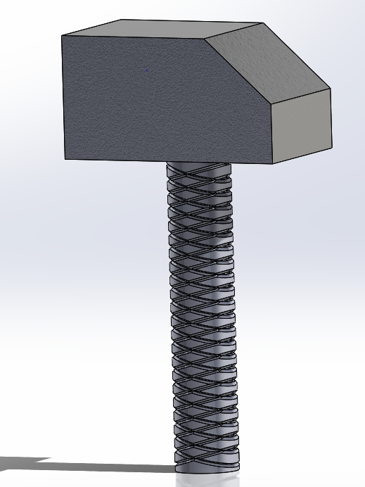
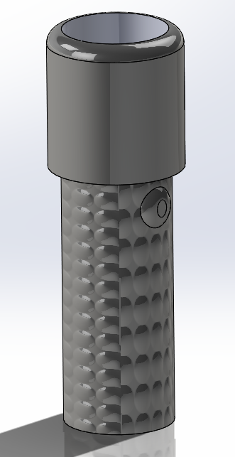
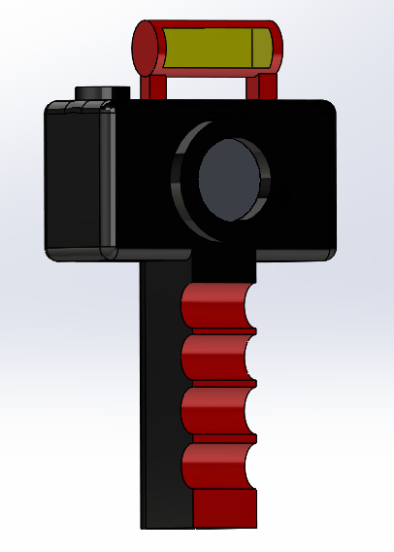
Traction
My own SolidWorks.
Traction is the adhesive friction of a body on some surface.
Traction is a vital application of grip.
Surfaces can be knurled,dimpled and finger indents can all be applied to help with traction.
A hammer with a knurled grip.
A torch with a dimpled grip
A camera grip with finger indents

Slide 7
My sketching of grips.

Slide 8
Thanks for your attention!
Hope you enjoyed my presentation

