Slide 1
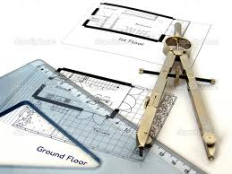
Technical Graphics
By Dylan Wray
Rang English

Slide 2
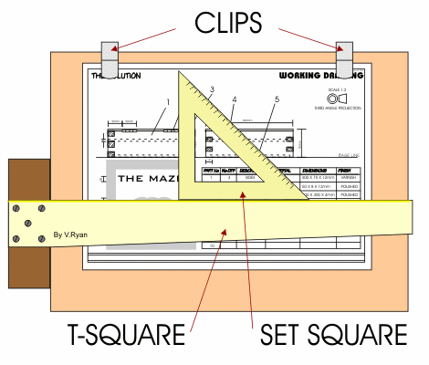
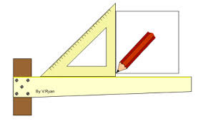
What we do
In t.g we draw symbols and logos. So far we’ve done 16 drawings.
We use a tee square, set squares and a compass.
We’ve been learning to draw different types of lines.

Slide 3
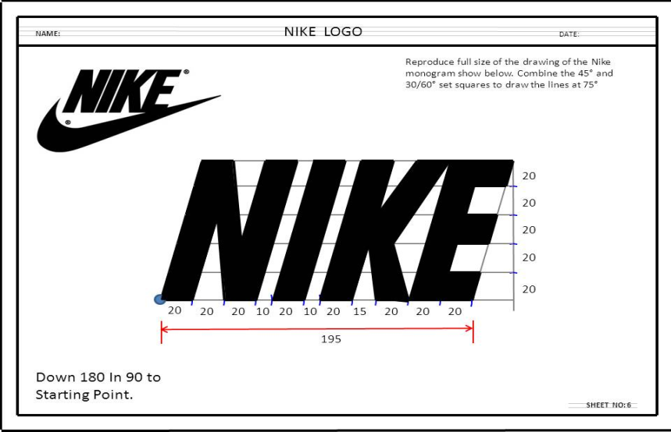
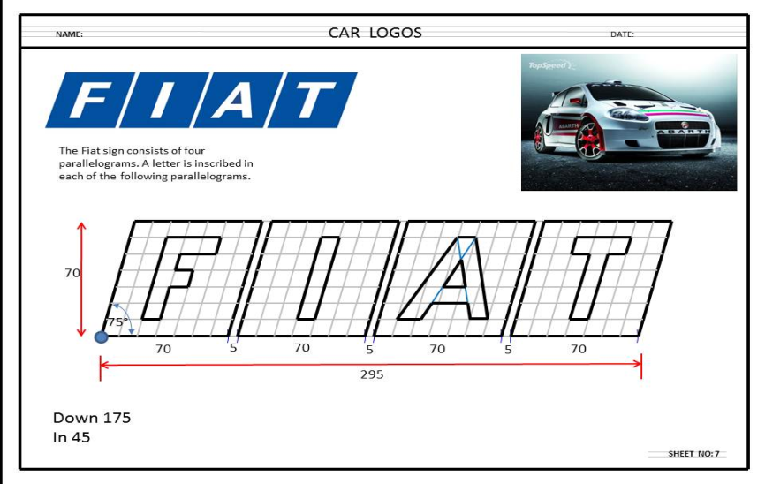
Examples of our work

Slide 4
A video on Technical Graphics

